Slide 1
Food Hub
Ping FOOD HUB and enjoy your food

Slide 2
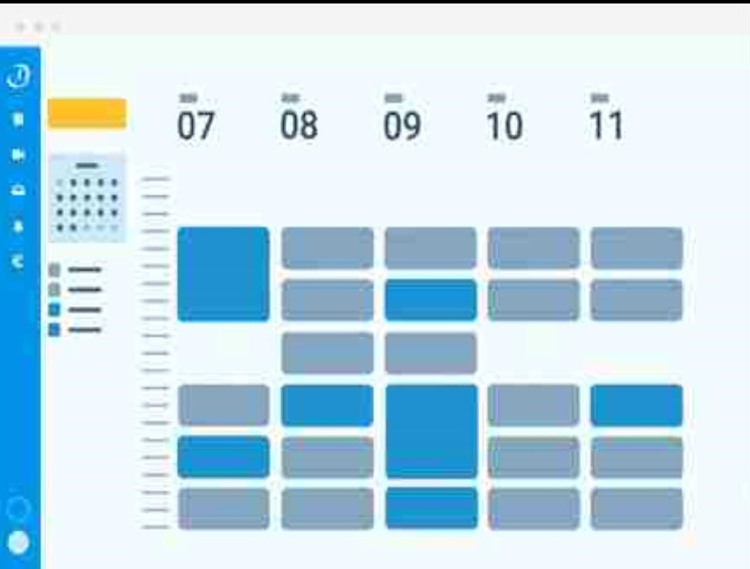
Agenda
Food Hub Journey
Problem Statement
Project Management
Tech Stack and Architecture
Application Demo
Future Scope
Challenges
Conclusions
Q & A

Slide 3
Food hub
This is a microservice based application which can be used for food delivery for users/customers.
The customers will be able to order food on online either through separate order or by selecting pre-defined monthly or weekly plans or by customizing plans as per needs of the users.

Slide 4
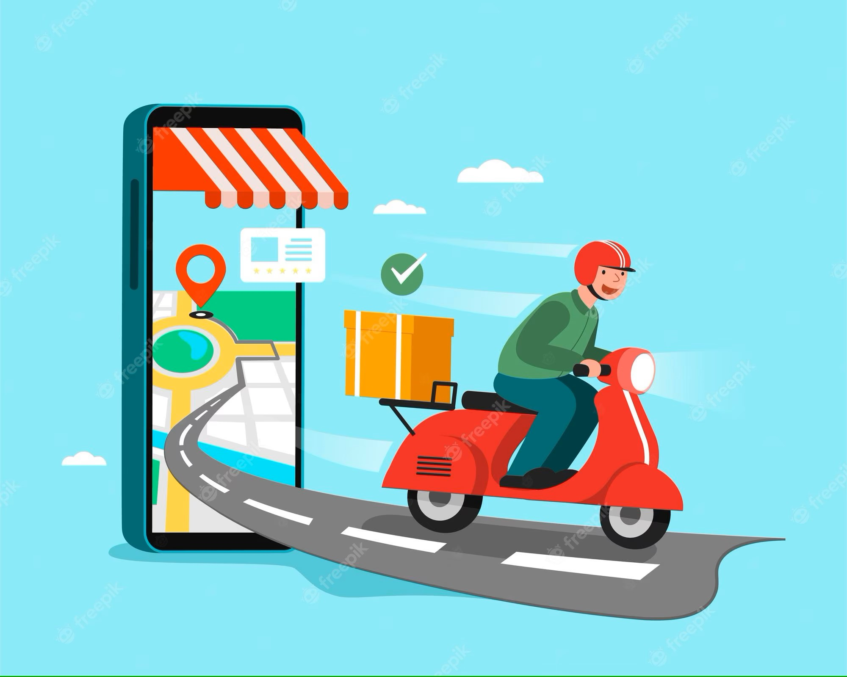
Benefits for User/Customer
Customers can order food online using
FoodHub from wide variety of products.
2. PG Users will be able to select from
pre-defined meal plans as per their
pocket.
Meal plans will be available for discounted
price points.
4. Weekly/Monthly plans can be selected as
required.

Slide 5
Food Hub Journey
January 3rd
January 3rd
January 23rd
February 2nd
February 3rd
Deployment
Presentation of Food hub
Team formation
Topic selection
Development

Slide 6



Learning Phase
BACKEND
& DB
TESTING
Docker
Aws Docker,ECR,ECS,
Fargate
M
Junit & Mockito
Devops / monitoring
CLOUD-AWS
MySQL,H2 Database ,Spring core & Boot ,Microservices,Swagger REST,MVC

Slide 7
Product phase
Environment setup
Module Division
Order Request
Delivery Services
Start
End
Topic approval & Abstract Submission
Add Menu
Generate Bill

Slide 8








Environment Setup
These are the tools used for the project set up :
JAVA
STS
Postman
Zipkin
MySQL,
Intellij
Maven
Docker
Kubernetes

Slide 9
Module Division
Customer-Subscriber Service :
In this service the customer/user will be able to register himself with the application and will be able to update his details, delete his details and other operations. This service will contain the registration of subscribers, and their selection of subscription plans or customization of their plans after their registration.
Food Service :
This service will contain the overall food menu options such as adding into food menu, updating the existing menu and deleting the unpopular menu options for user. It will also contain subscribers’ food plans.

Slide 10
Order Service :
This service will process the order details of subscribers as well as the
order details for normal single order by the normal customers.
Billing Service
This service will do all the billing of the orders being processed by order service
from the customers. And will generate the invoice and these orders will further
being processed to the delivery service for delivery.
Delivery Service :
This service will allot the orders being confirmed by the billing service to the
available delivery person and will check the status of the orders constantly until
they being delivered.

Slide 11
Flow chart

Slide 12

Start
Type of User
User
Admin
Select Meal Items
Add Menu Items
Select Quantity
Update Items
Select Meal Items
Add Menu Items

Slide 13
Select Quantity
Update Items
Payment
Delete Items
Review
End

Slide 14
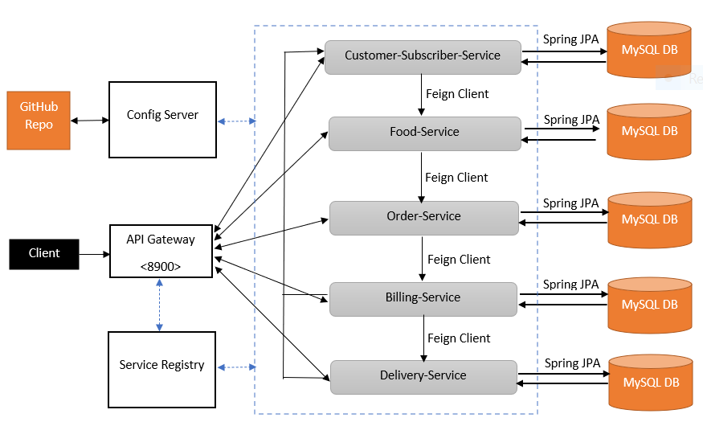
Food Hub Architecture

Slide 15
Tech Slack and Architecture

Slide 16



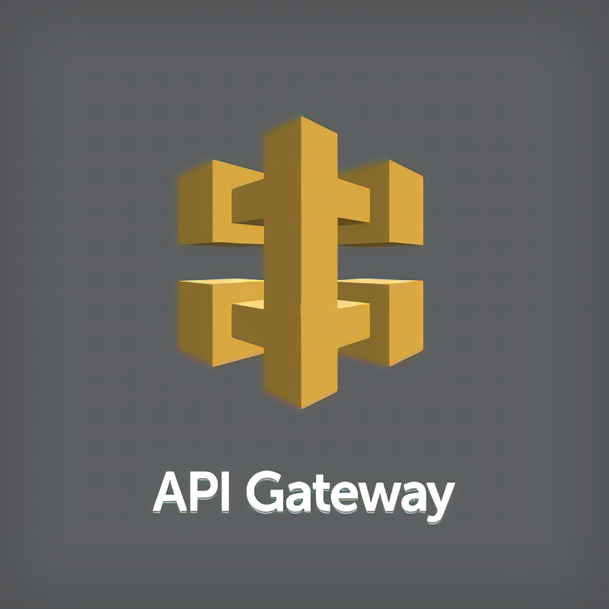


Backend & DB

Slide 17


DevOps/
Cloud -AWS

Slide 18
Agile Methodology

Slide 19
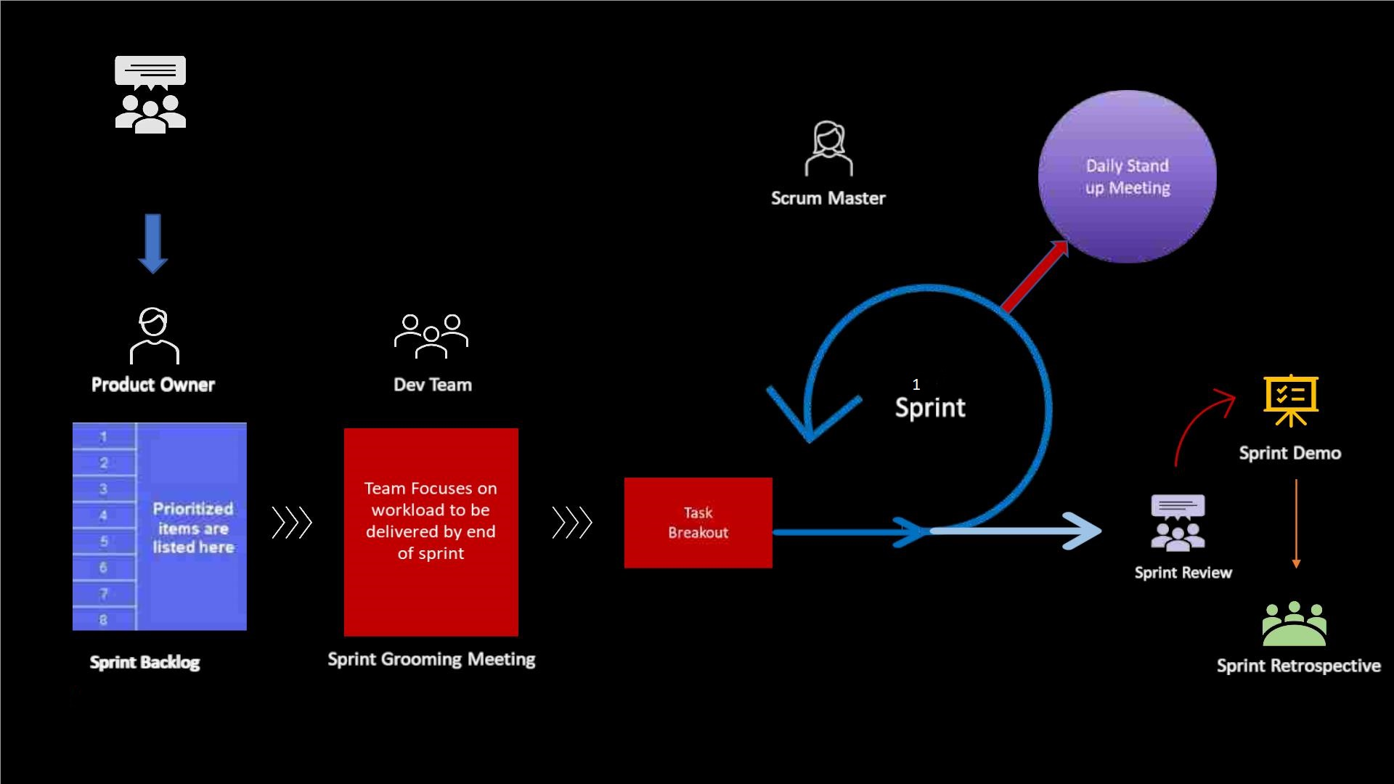

Slide 20
Application Demo

Slide 21

Conclusion

Slide 22
Team Members
Pratik Barahate
Ashok Pathuri
Sreepriya O S

Slide 23
Testimonials

Slide 24
POC Testimonial

Slide 25
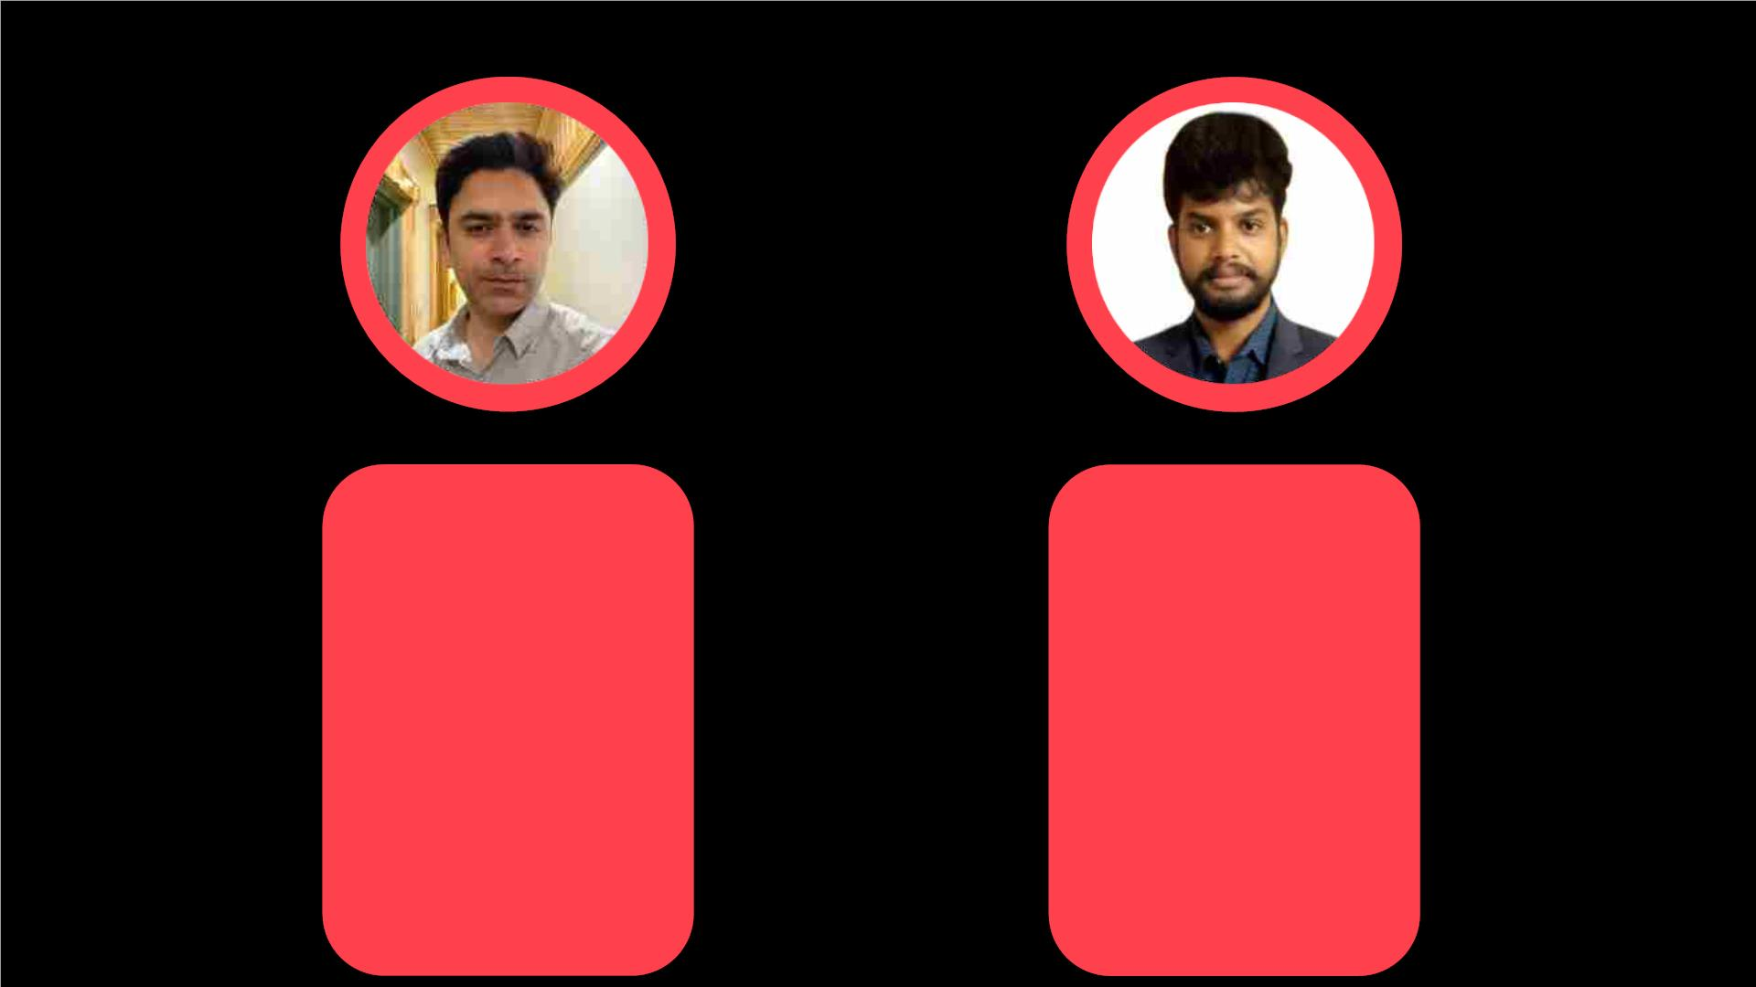
Trainer Testimonials
Kudos to the team for completion of their Entire Training Program. I have seen aggressiveness and proactiveness to work on the area of improvement whenever needed. Appreciate to the entire team to achieve the Training Goal and expectation together. Each of the team members has developed the different Core values like Inclusive Collaboration, Learning Mindset, Partnering for client impact, Engaging with Openness. Congratulations to each one of you. Proud of you My Team. Best of luck each one of you.

Slide 26
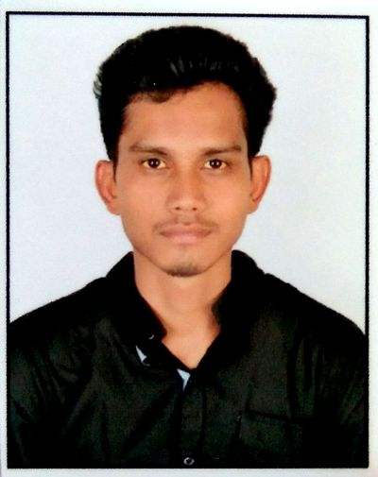
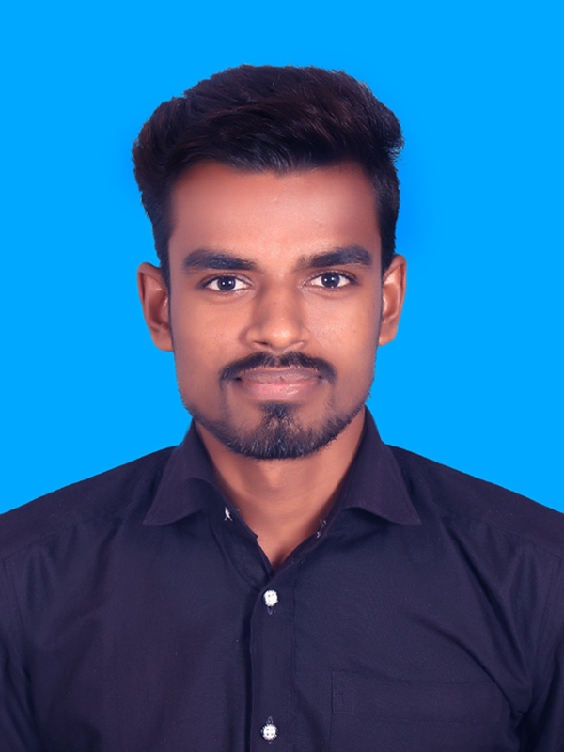
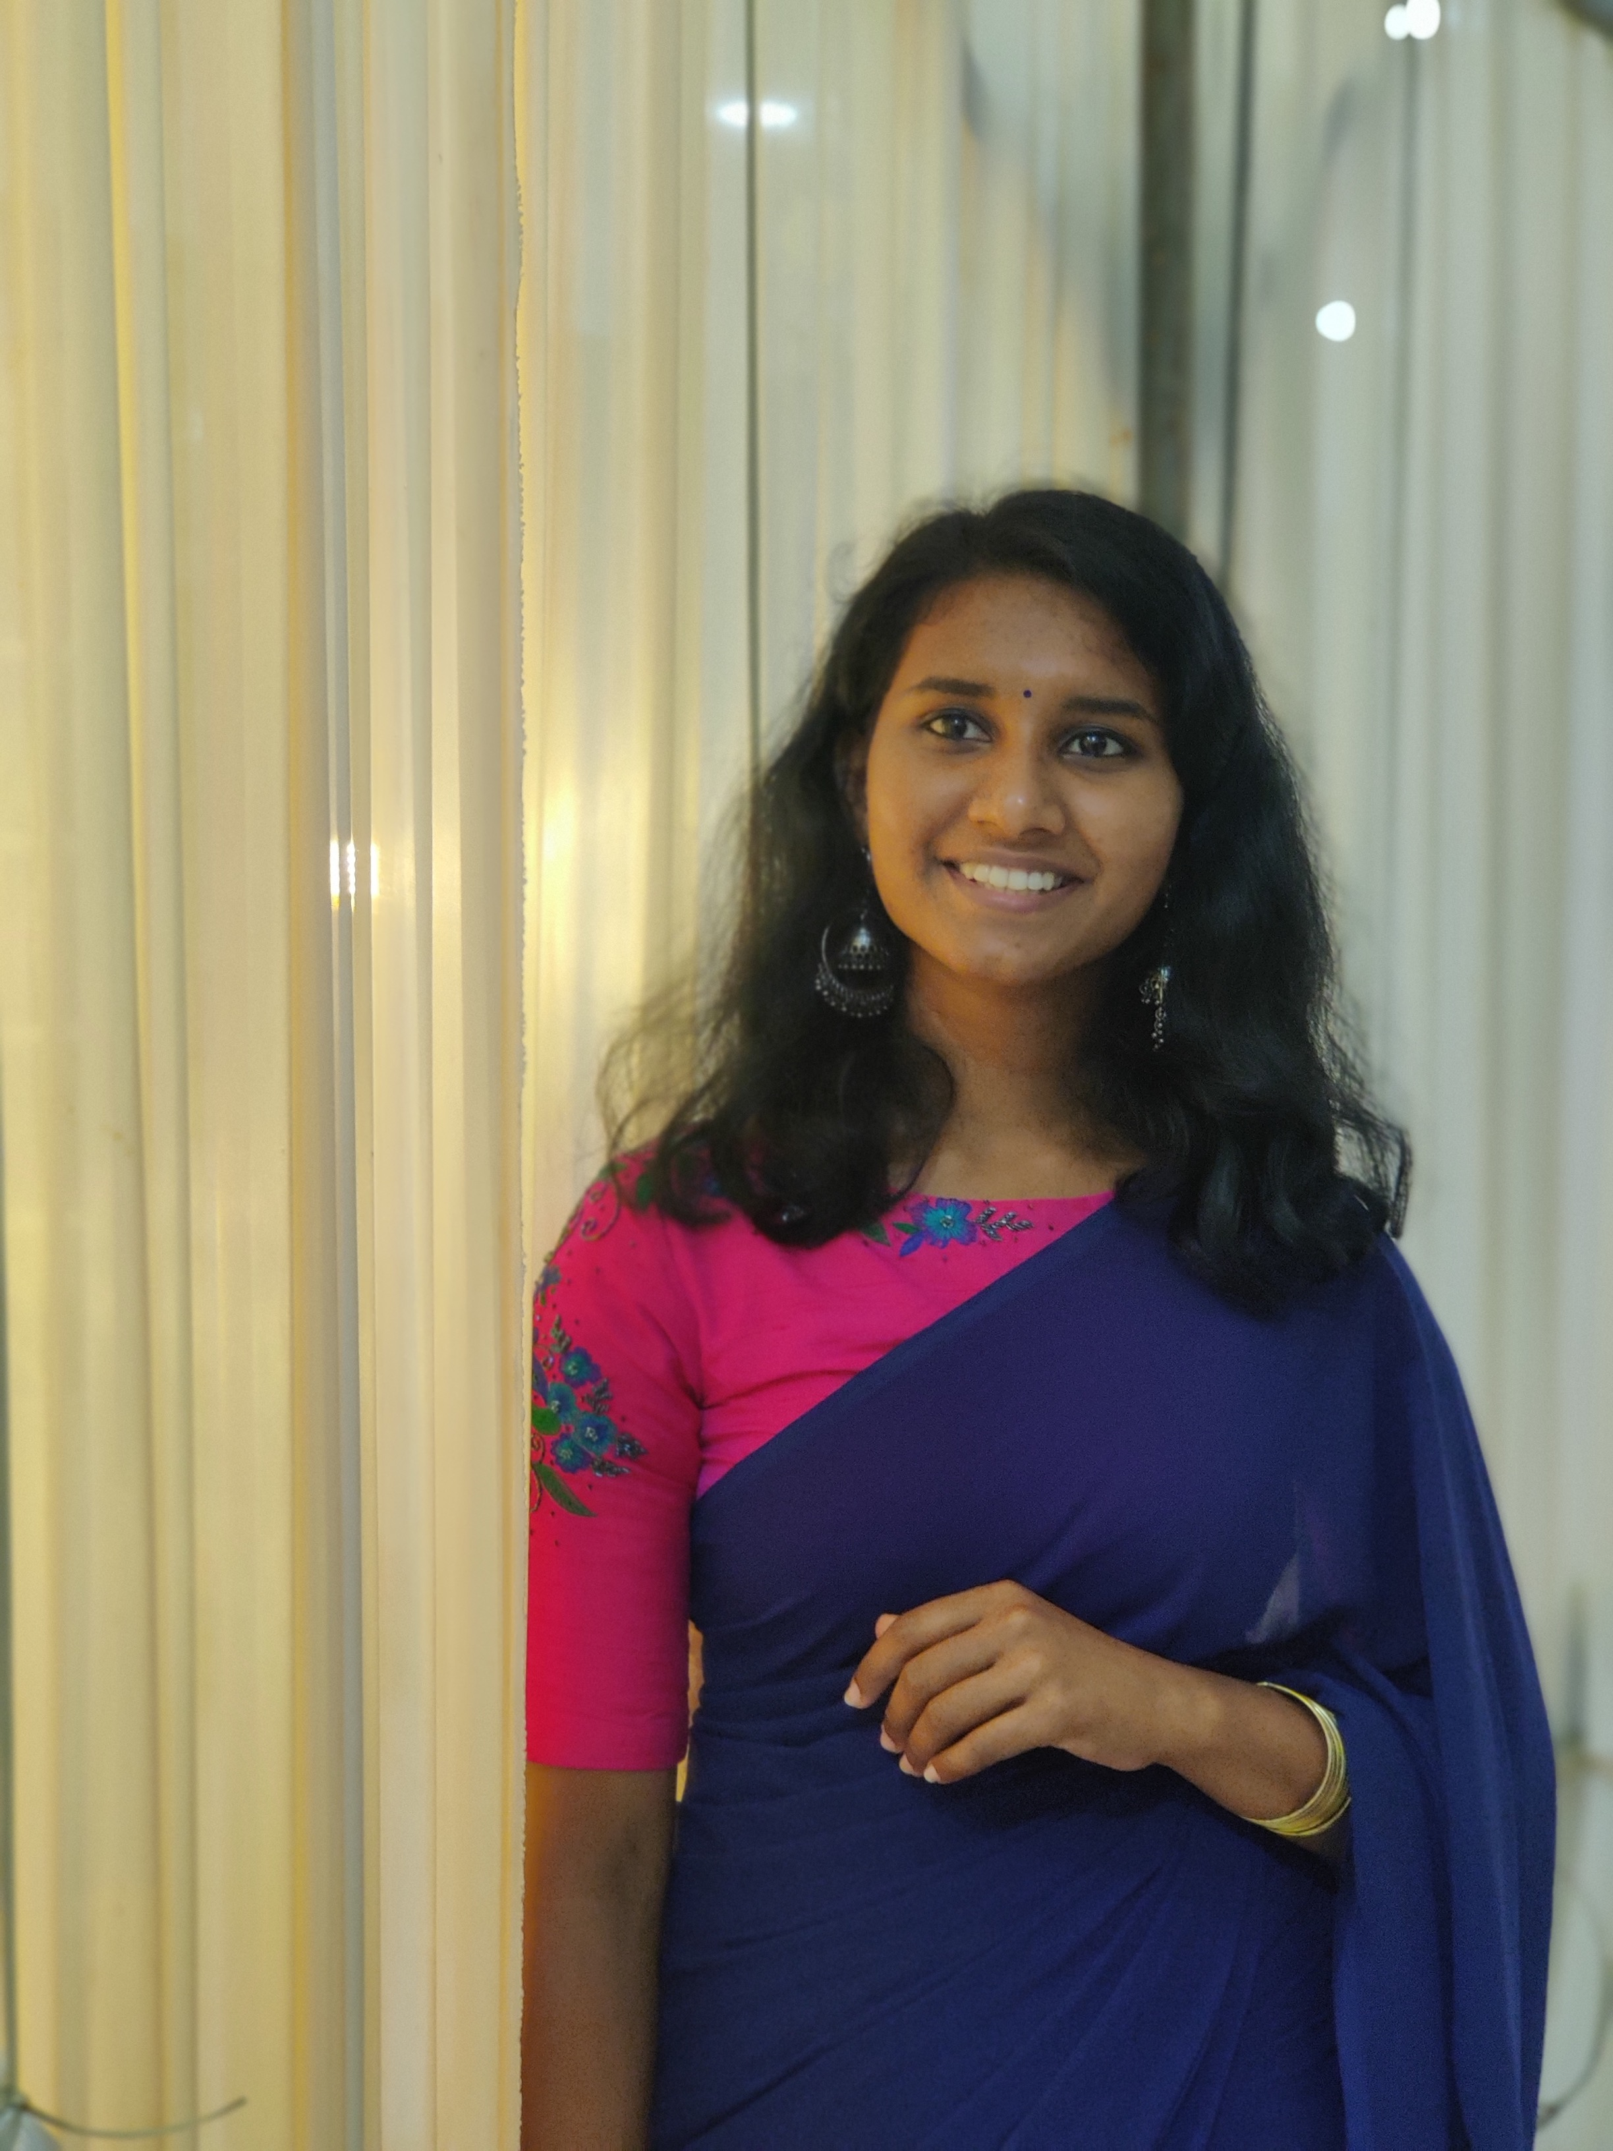
Batch Testimonials
It was a great learning experience. I learned about the technologies and the project by coordinating with each team .Thank you to the entire team for the good collaboration during the whole training.
Overall , It was a great experience . It was challenging journey but learned a lot of new technologies, what are industry standards. and also learnt how real projects works.
For me it was good exposure , and got chance to learned to learn new technologies .Kudos to the entire batch for engaging with the whole project. Thank you all.

Slide 27

Q & A

Slide 28
Thank you

